Slide 1



CAPSTONE PROJECT
bike-rental-demand-prediction
Presented By
Student Name: Siddharth vinod wani
College Name: dnc college Jalgaon
Department: computer science
Email ID:siddharthwani71@gmail.com

Slide 2
OUTLINE:
Problem Statement (Should not include solution)
Proposed System/Solution
System Development Approach (Technology Used)
Algorithm & Deployment
Result (Output Image)
Conclusion
Future Scope
References

Slide 3
Problem Statement:
In many urban cities, rental bikes are widely used for daily transportation. However, managing the availability of bikes at the right time and location is a major challenge. Sometimes bikes are not available when demand is high, and at other times bikes remain unused. This happens due to the lack of accurate prediction of bike demand. An efficient system is required to analyze historical data and understand demand patterns to support better bike distribution and management.

Slide 4
Proposed Solution:
The proposed system aims to predict the number of rental bikes required on an hourly basis using machine learning techniques. The system analyzes historical bike rental data along with time-based factors to forecast future demand. By providing accurate predictions, the system helps in improving bike availability, reducing waiting time for users, and optimizing resource utilization.

Slide 5
System Approach:
Technologies Used
Microsoft Azure Machine Learning
Python Programming Language
Azure ML Studio
CSV Dataset
Cloud Computing Environment
Development Approach
Collect historical bike rental data
Preprocess the data to remove errors and missing values
Train the machine learning model using Azure ML
Test and evaluate the model
Deploy the model on Azure cloud for predictions

Slide 6
Algorithm & Deployment:
Algorithm Used
Linear Regression / Time Series Forecasting Algorithm
Algorithm Process
Input historical data such as date, time, and bike count
Train the model using Azure ML Studio
Identify demand patterns from past data
Predict future bike demand on an hourly basis
Deployment
The trained model is deployed using Microsoft Azure
Predictions are accessed through the Azure ML interface

Slide 7
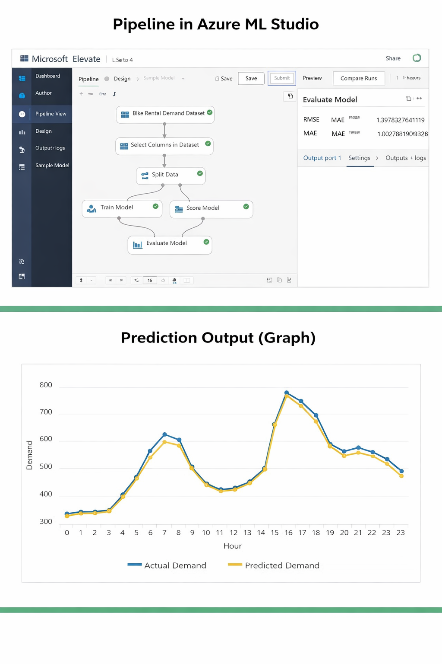
Result:
The system successfully predicts the required number of rental bikes for each hour. The output graph shows a comparison between actual bike demand and predicted demand. The predicted values closely match the actual values, which indicates good accuracy and reliability of the model. This result confirms that the system can support better planning and decision-making.

Slide 8
Conclusion:
The Bike Rental Demand Prediction System demonstrates how machine learning and cloud technology can be used to solve real-world transportation problems. Accurate demand prediction helps in efficient bike distribution, reduced waiting time, and improved user satisfaction. Microsoft Azure Machine Learning provides a reliable platform for developing and deploying predictive models.

Slide 9
Future scope:
Integration of real-time weather data
Use of advanced algorithms such as LSTM
Expansion of the system to multiple cities
Mobile application integration
Real-time demand prediction and monitoring

Slide 10
References:
Microsoft Azure Official Documentation
Kaggle Bike Sharing Dataset
Online Machine Learning Tutorials
Research Papers on Demand Prediction
GitHub Link: https://github.com/username/bike-rental-demand-prediction

Slide 11
Thank You

